Slide 1
ChatApp
Team members:
Ahmed Shrief Ramadan
Romany Nagy Rizk
Mohamed Badawy

Slide 2

3
INTRODUCTION
I’m On The Pursuit Of Happiness
CONTENTS
4
Problem Definition
Problem for project
5
Welcome Page
Table Of
View options
6
Login Page
Log in to App
7
Register Page
Register to App
8
Main Page
View main taps
9
chat Tap
View massege
11
Search Tap
Search for friend
12
Setting Tap
View the setting
13
Sign Out
Leave chat

Slide 3
Introduction…
We devolved this App to make people contact with other easily.
We offer many serveries to the user just he register or login to the App, he can contact with any person by sending message, pictures ,files.

Slide 4
Problem Definition…!
In the first when we build the program and have the idea, we said to ourself that we want to build ChatApp like WhatsApp because we like it too much its an effective program and helpful for much users in the world.
Start search in that project and get little idea of components of it then we direct work.
If you want to build program like that then you must get a strong Back-end knowledge to build database and connect your project to it and you want cloud messaging and consider of the few time that we can’t done all that things we decided to use Firebase that introduced by Google.
Way may have a lot of problems such as the mean difference between versions of the Gradle because if you search you will find the different implementation for the same thing and could be this method that you do it become legacy then you must search for another one compatible with your version.

Slide 5
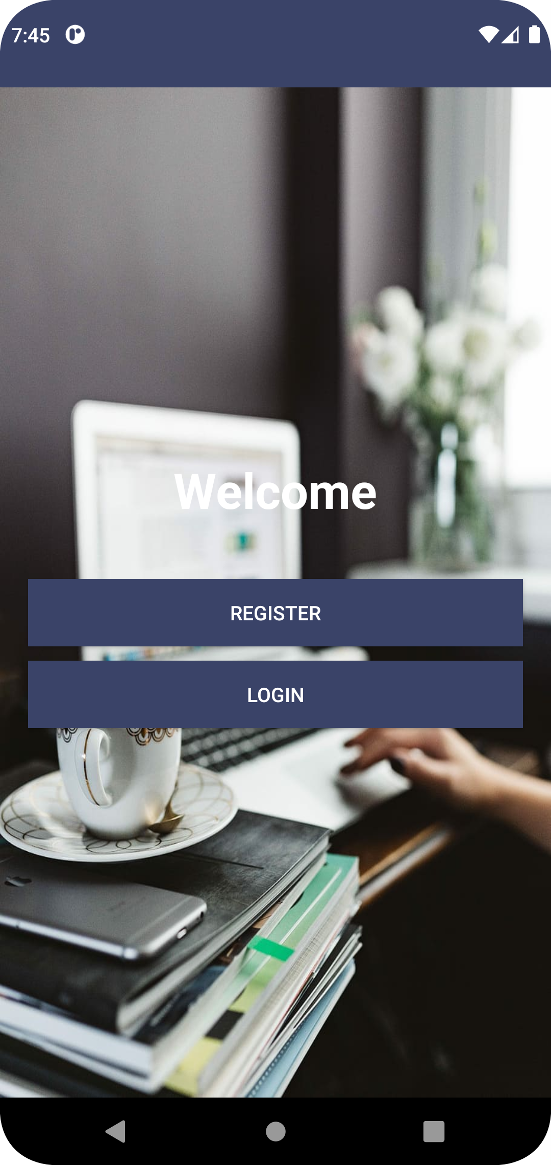
First page when you open the App is Welcome Page…
Welcome Page to ask you if you want to log into the App or you a new user and just want to Registeration.

Slide 6
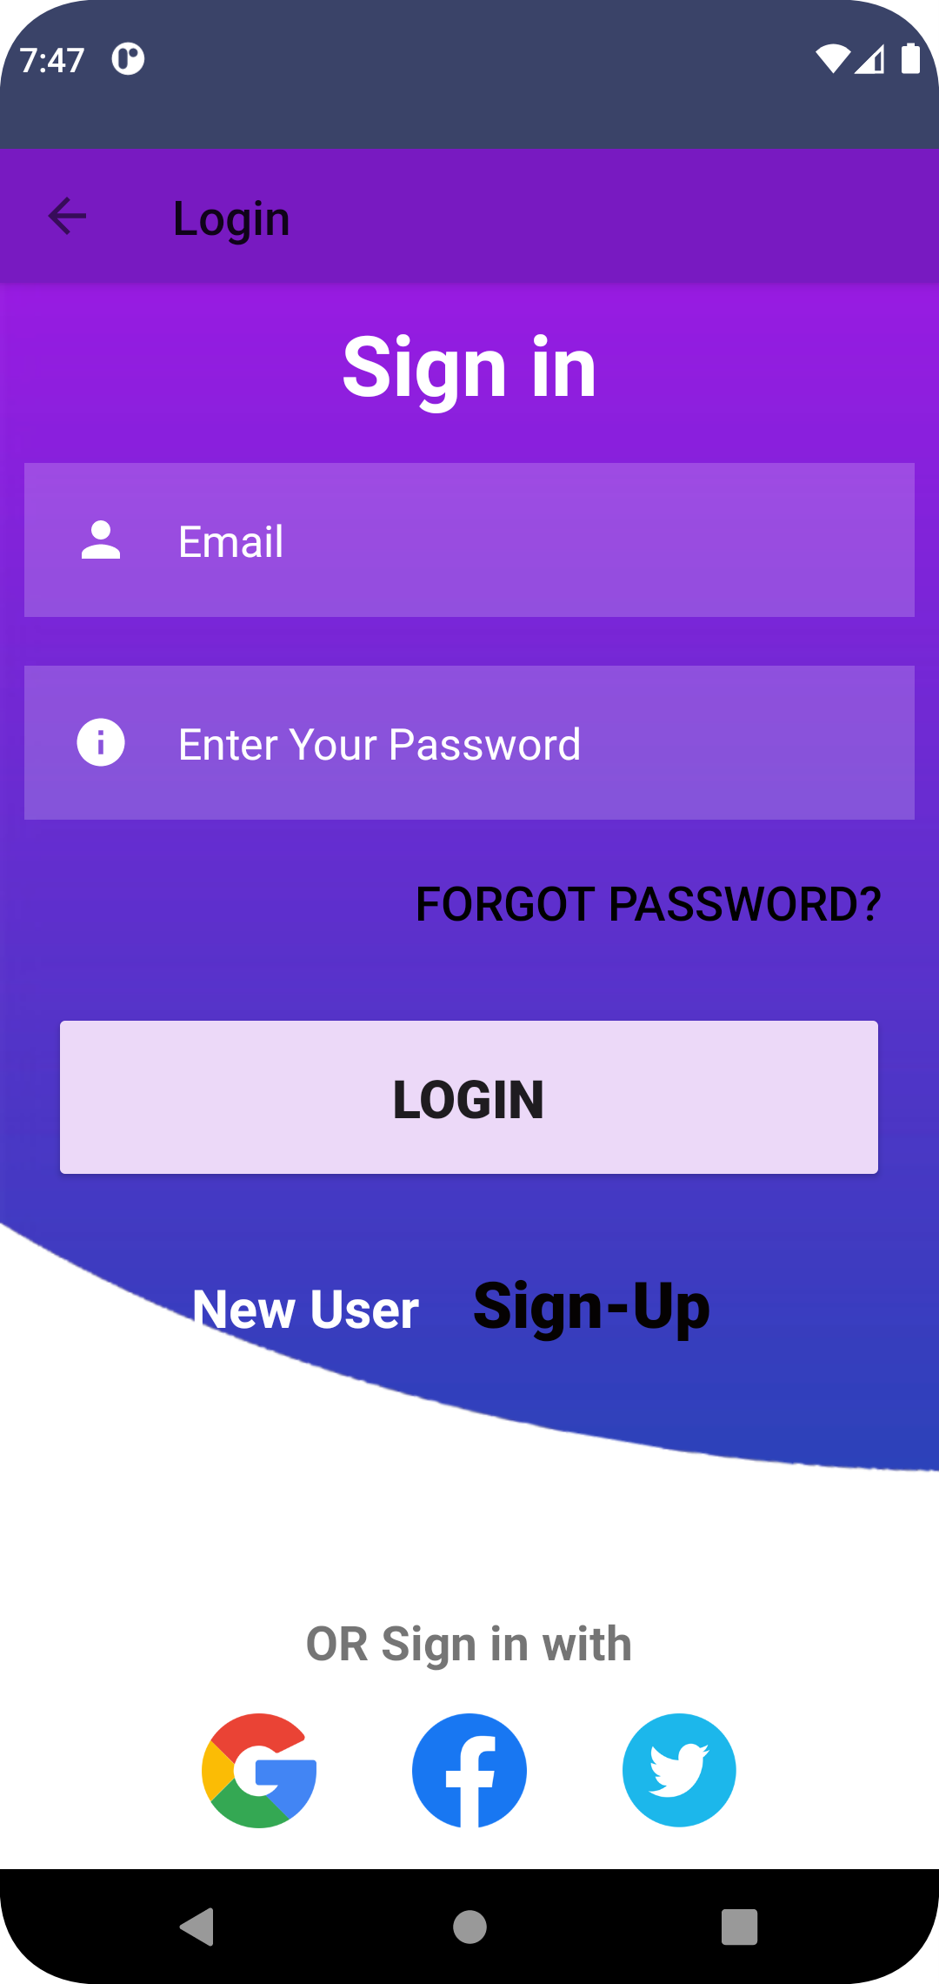
Login Page…
In Login page you can just login or you want to Sign up again.

Slide 7
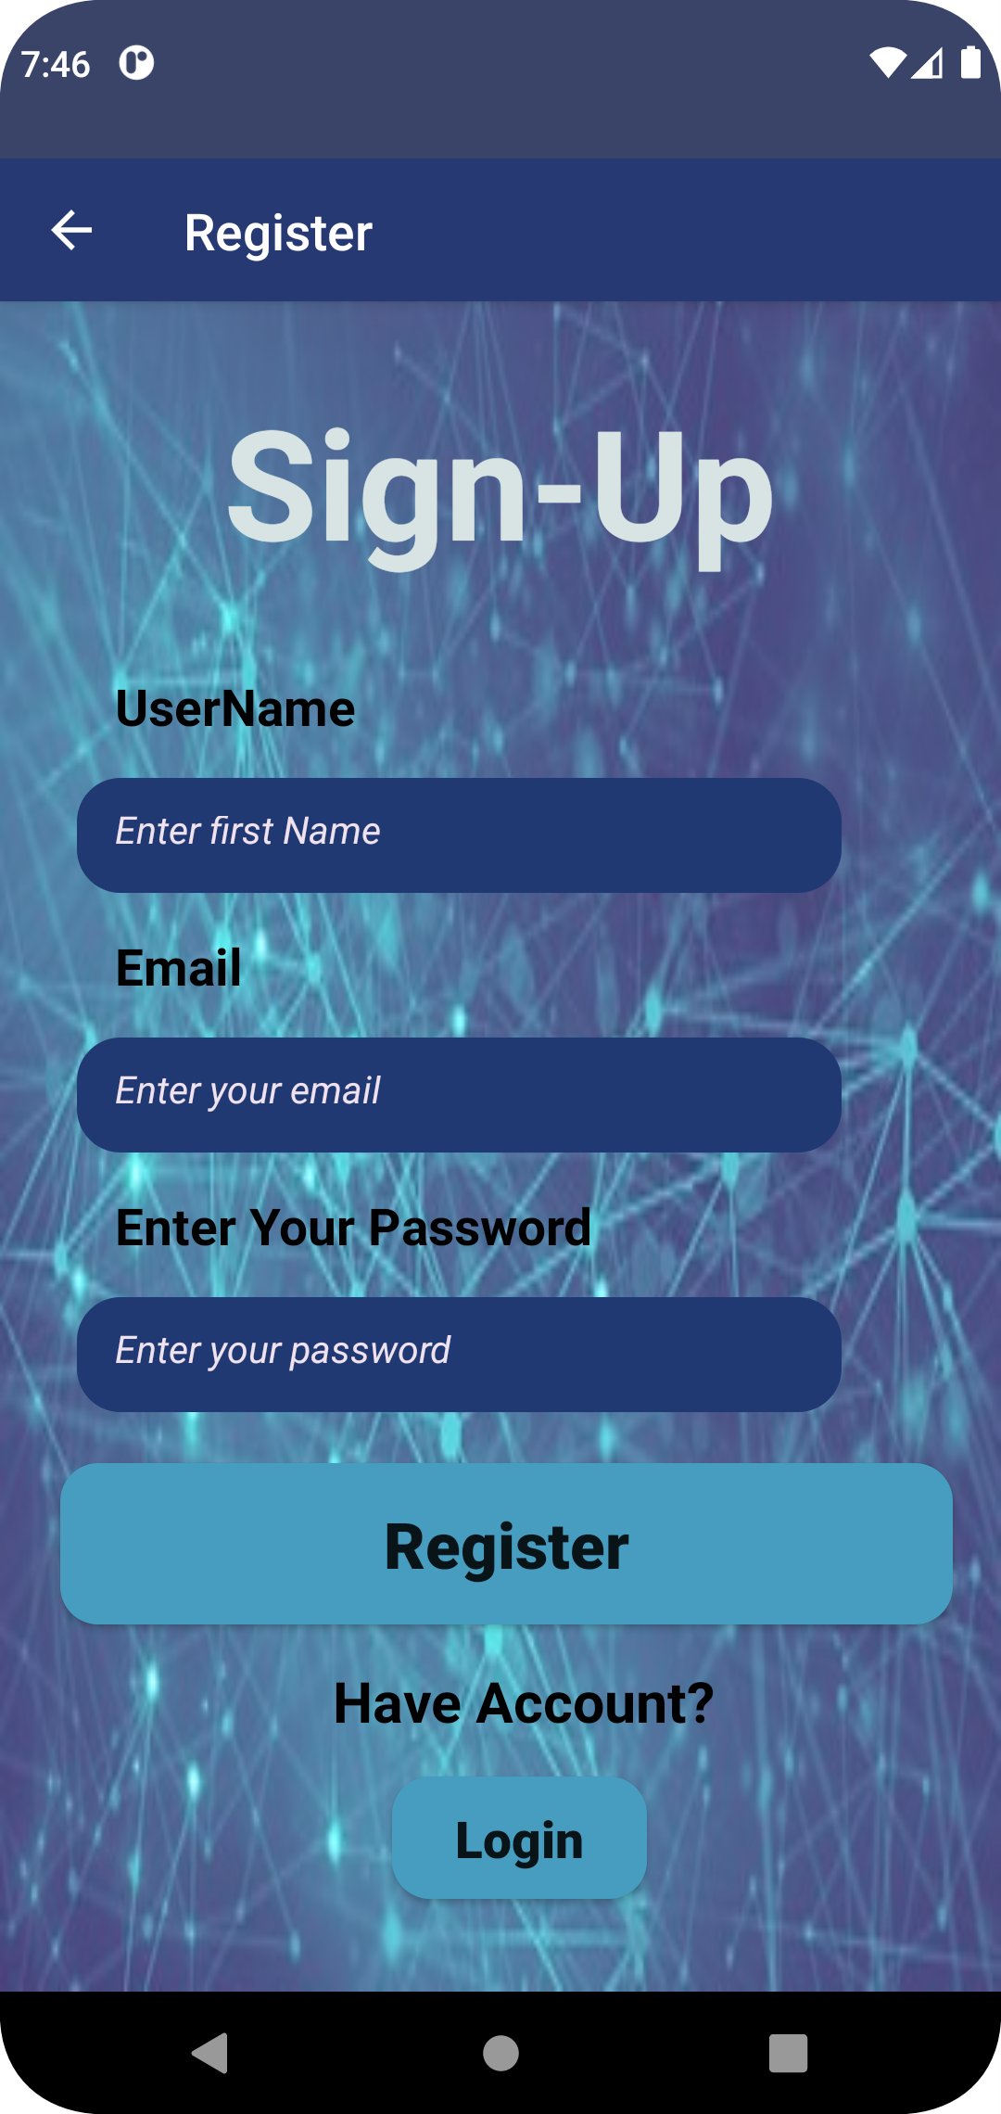
Registration Page…
Register by your username and Email to get into the App.

Slide 8
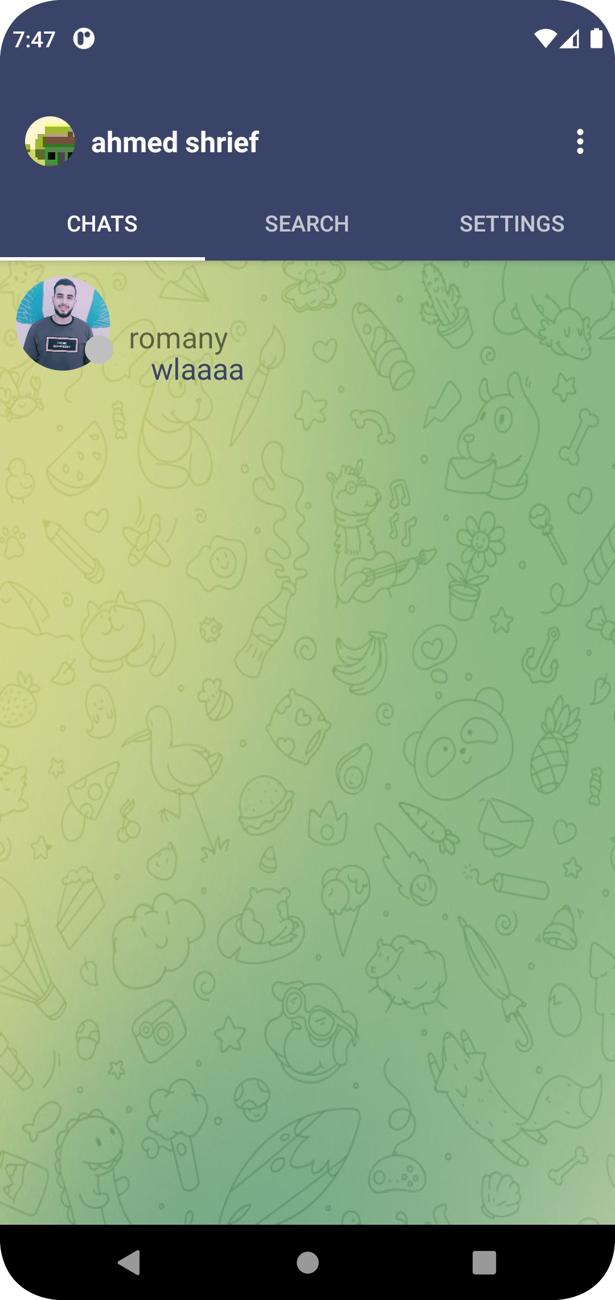
Main Page…
Here your main page that you can use the App.
All chats that you contact with will appear for you.

Slide 9
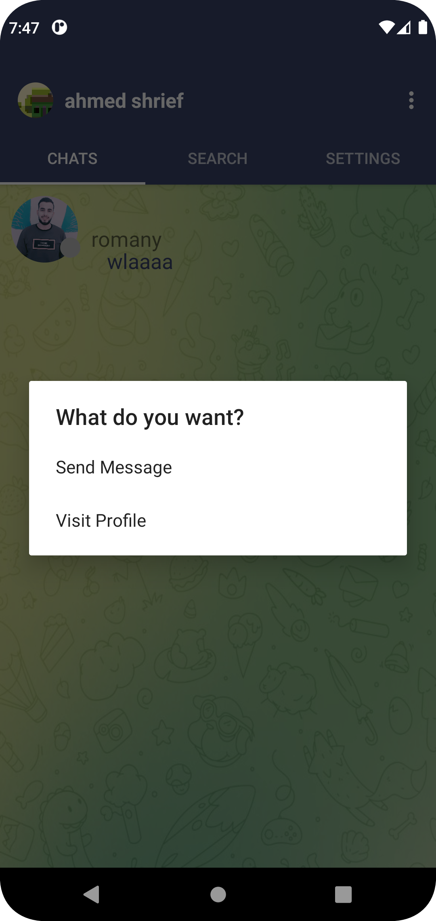
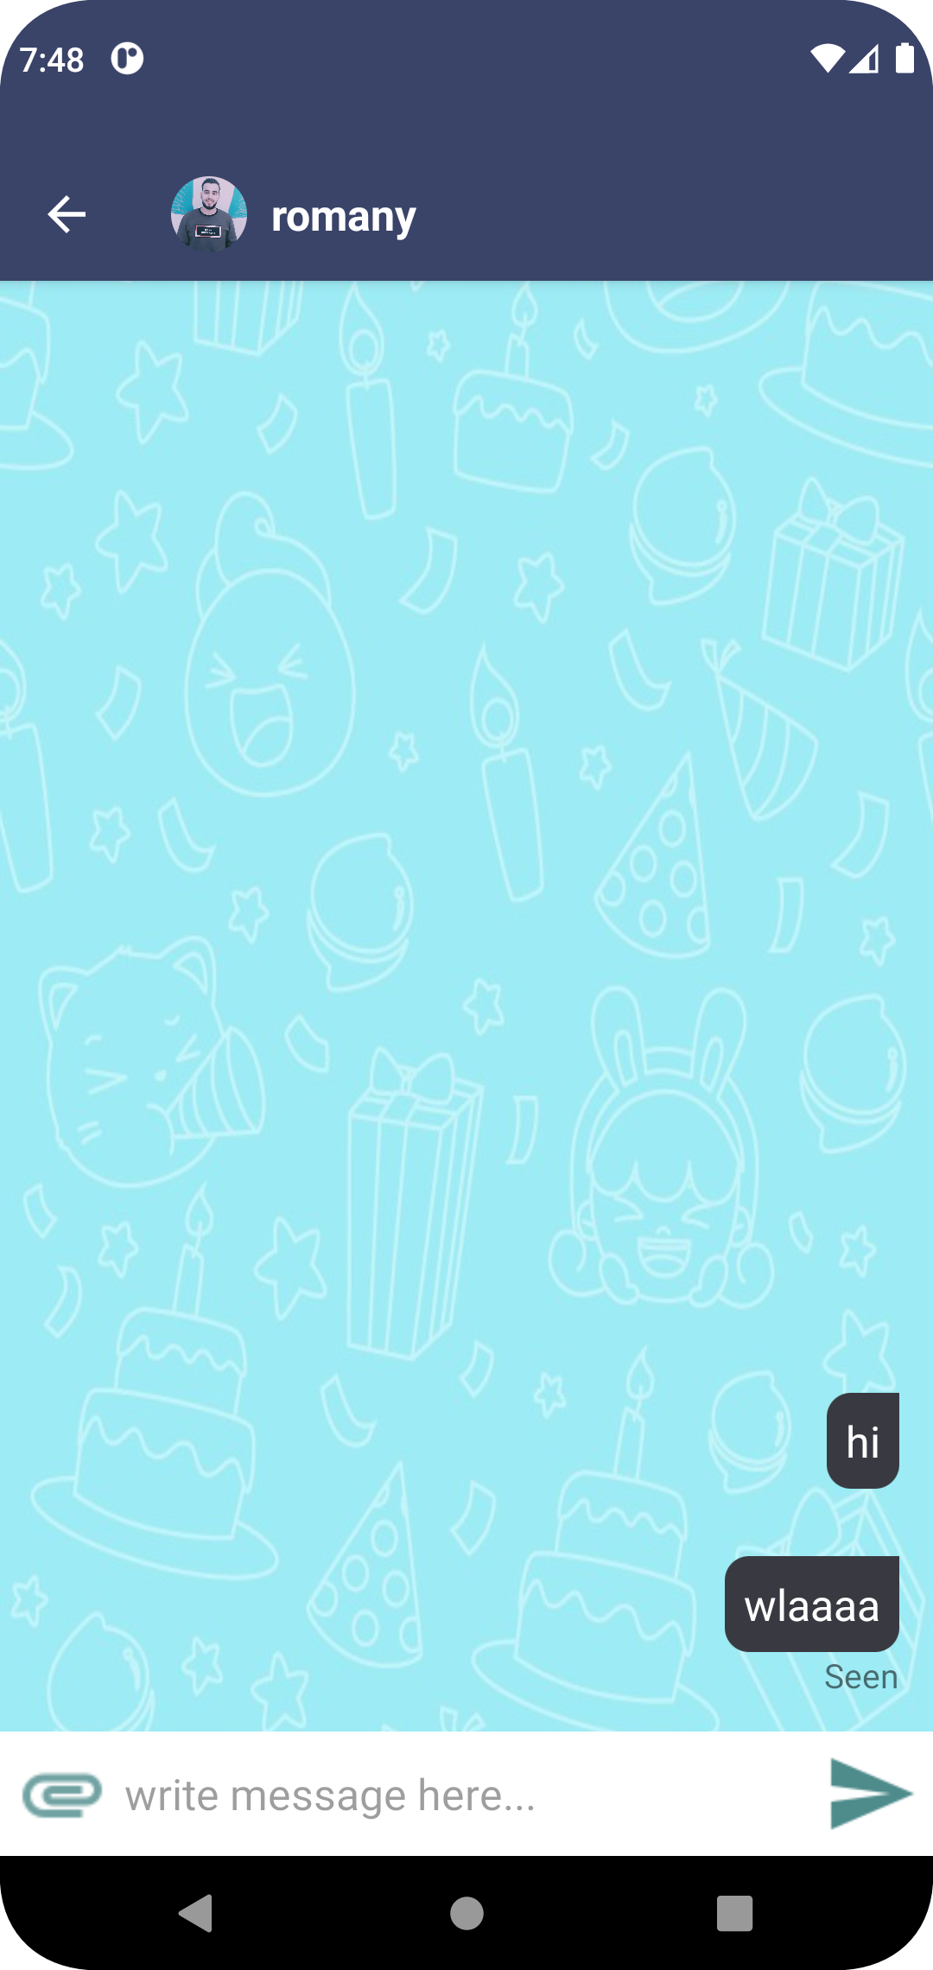
Get on the chat…
If you want to get on the chat, then you need just to click on the chat you want.
Get on the chat and have a good conversation.
You can send text or files.

Slide 10
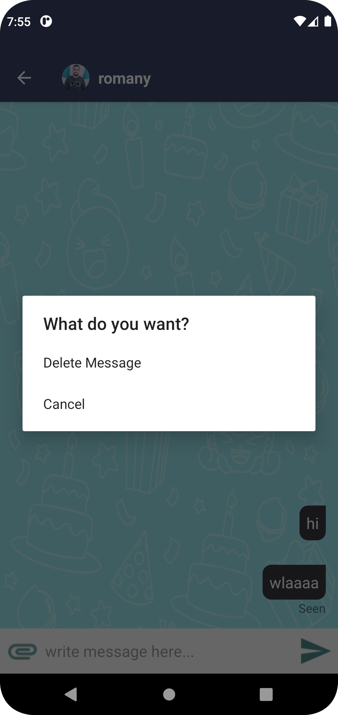
Delete Message…
If you want to delete certain message, then press on it .
You will appear for you two options ask you if you want delete message or cancel it.

Slide 11
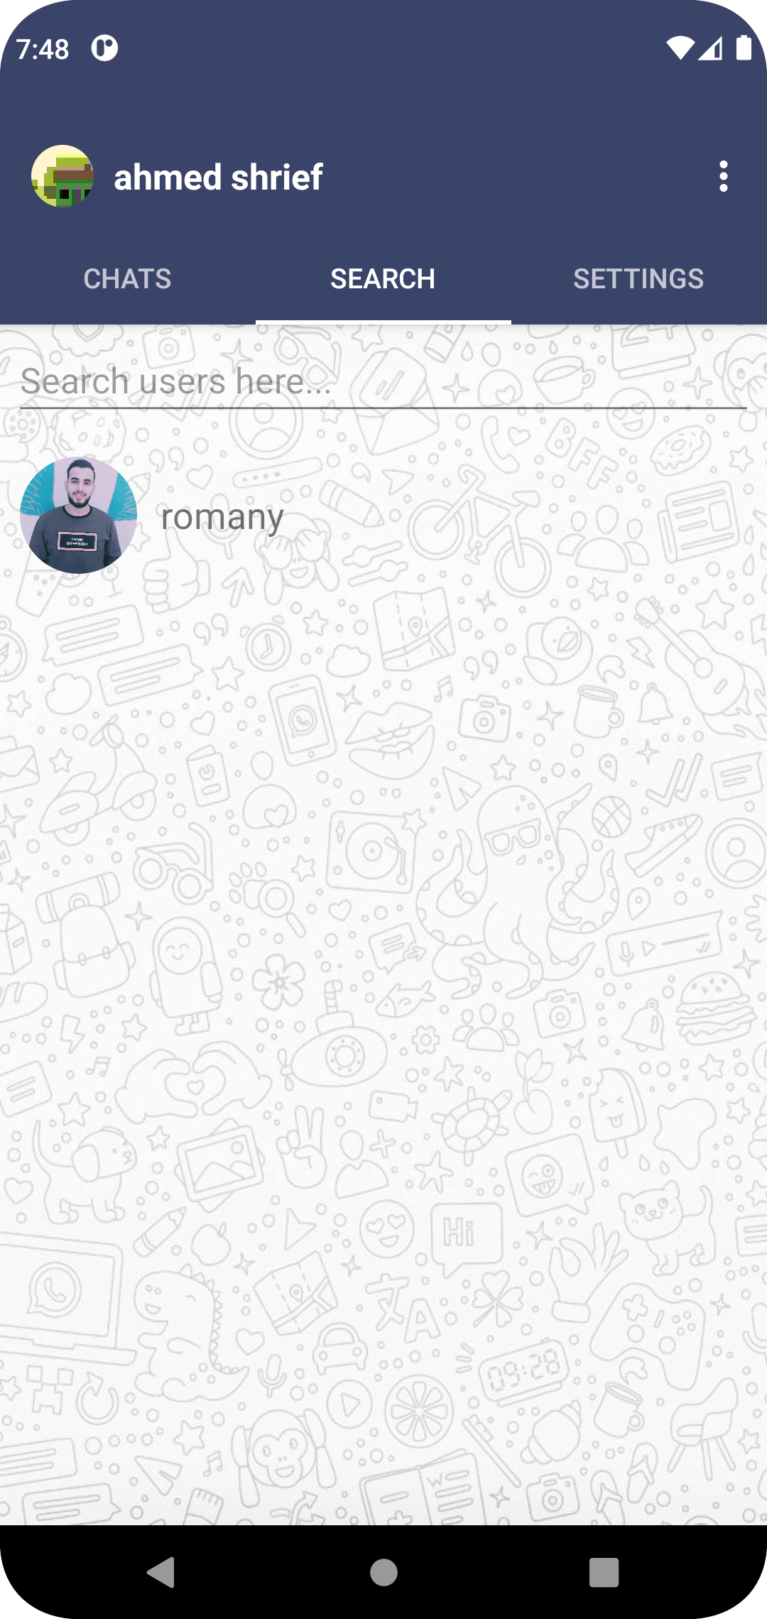
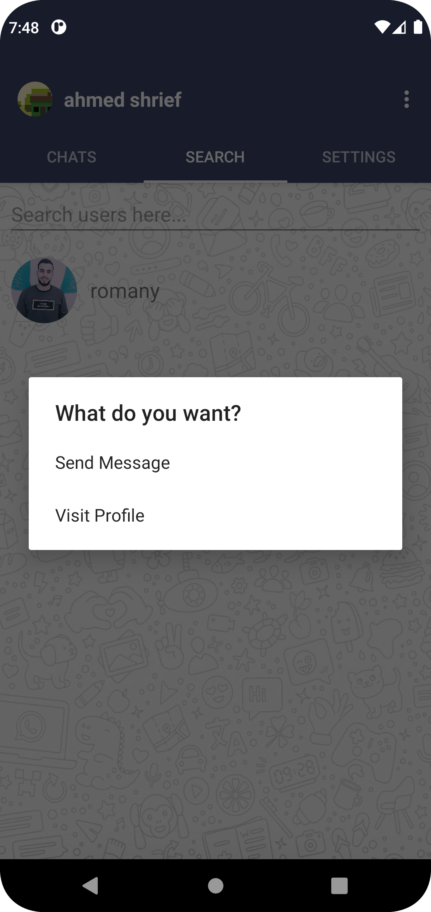
Search Tab…
This tab allows you to search for users that they have the App.
If you click on user, box will appear to you ask if you want to send message or view profile.

Slide 12
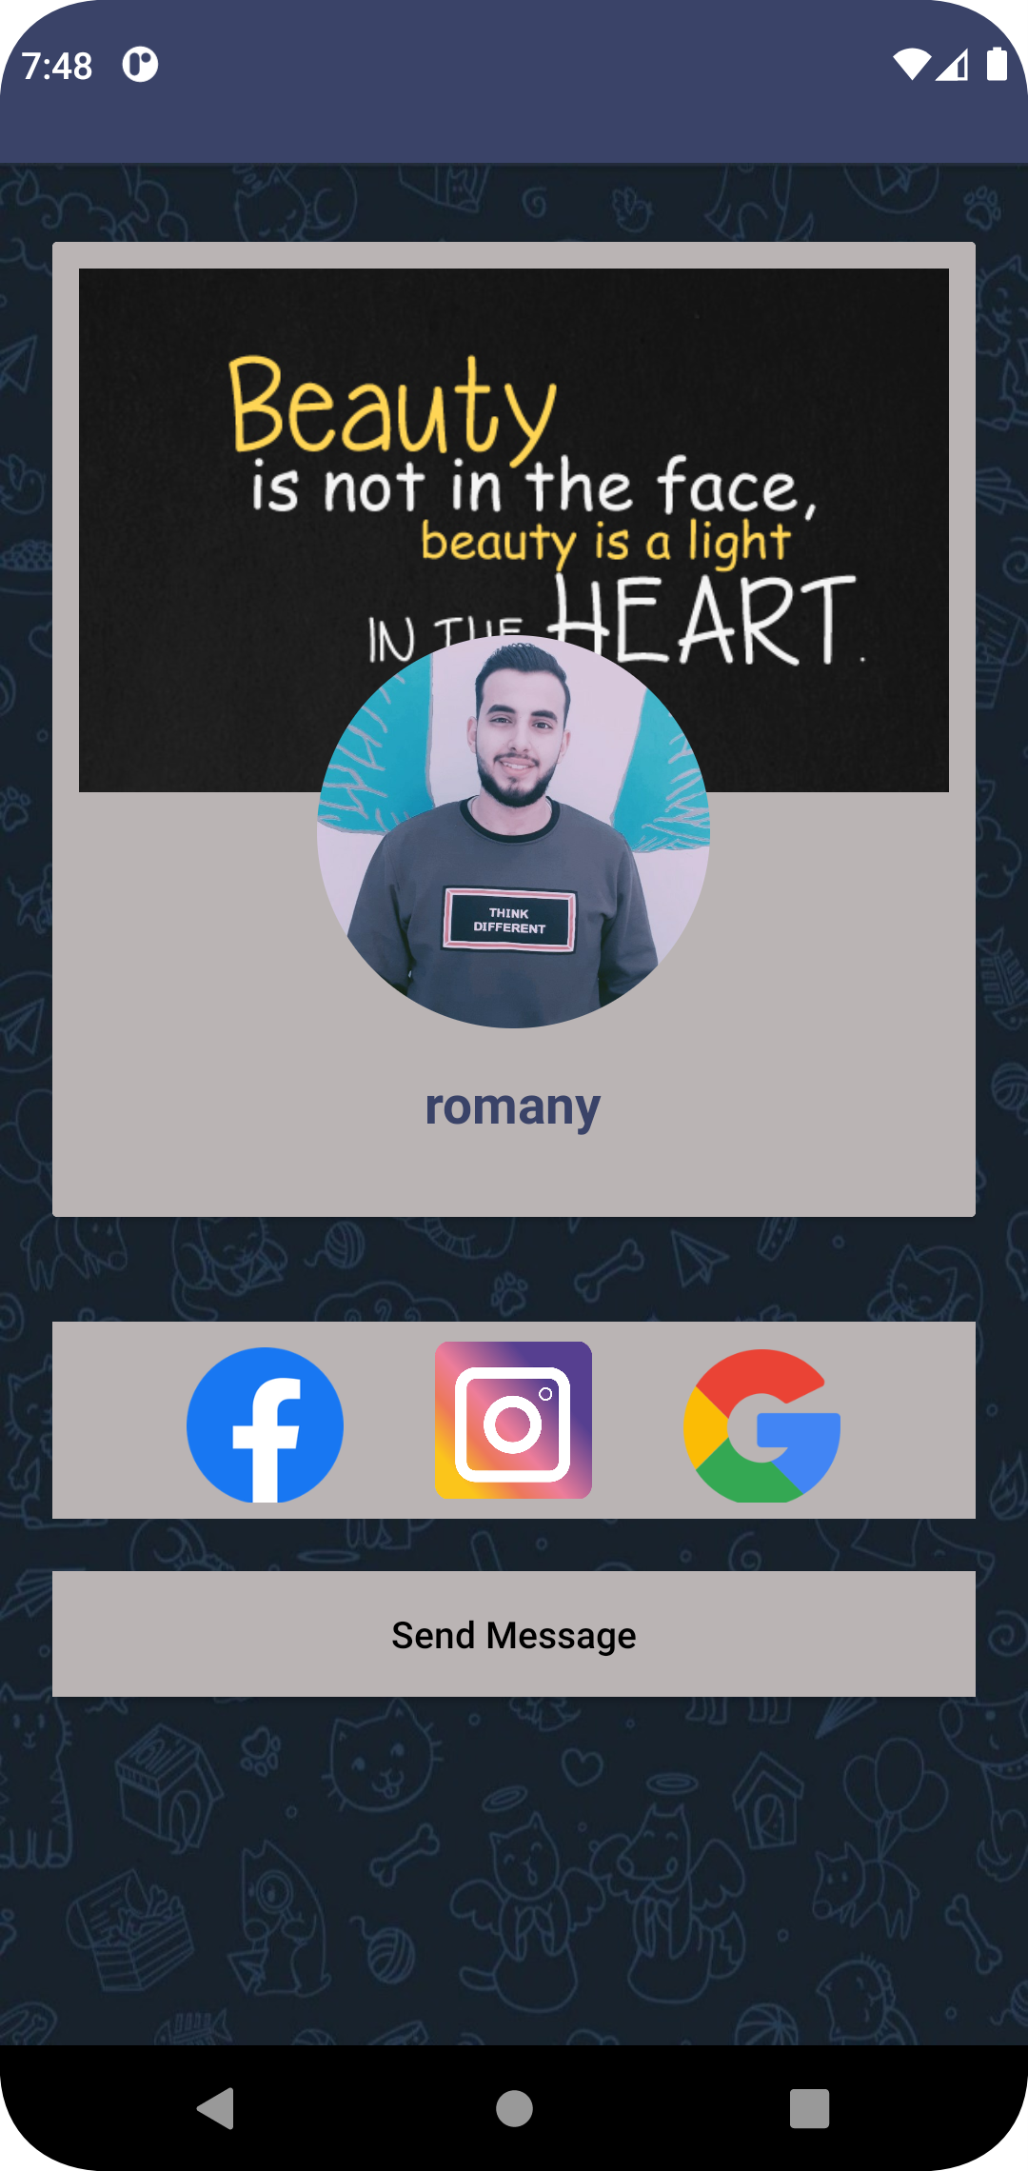
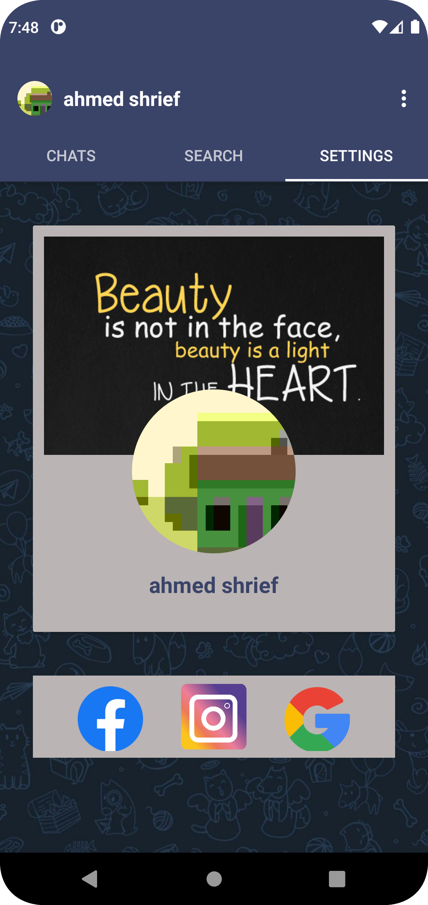
Settings Tab…
If you visit the user profile will appear to you as like that.
If you press on settings tab, you have here so many features.
Change your Profile and cover image.
Add your social media account.

Slide 13
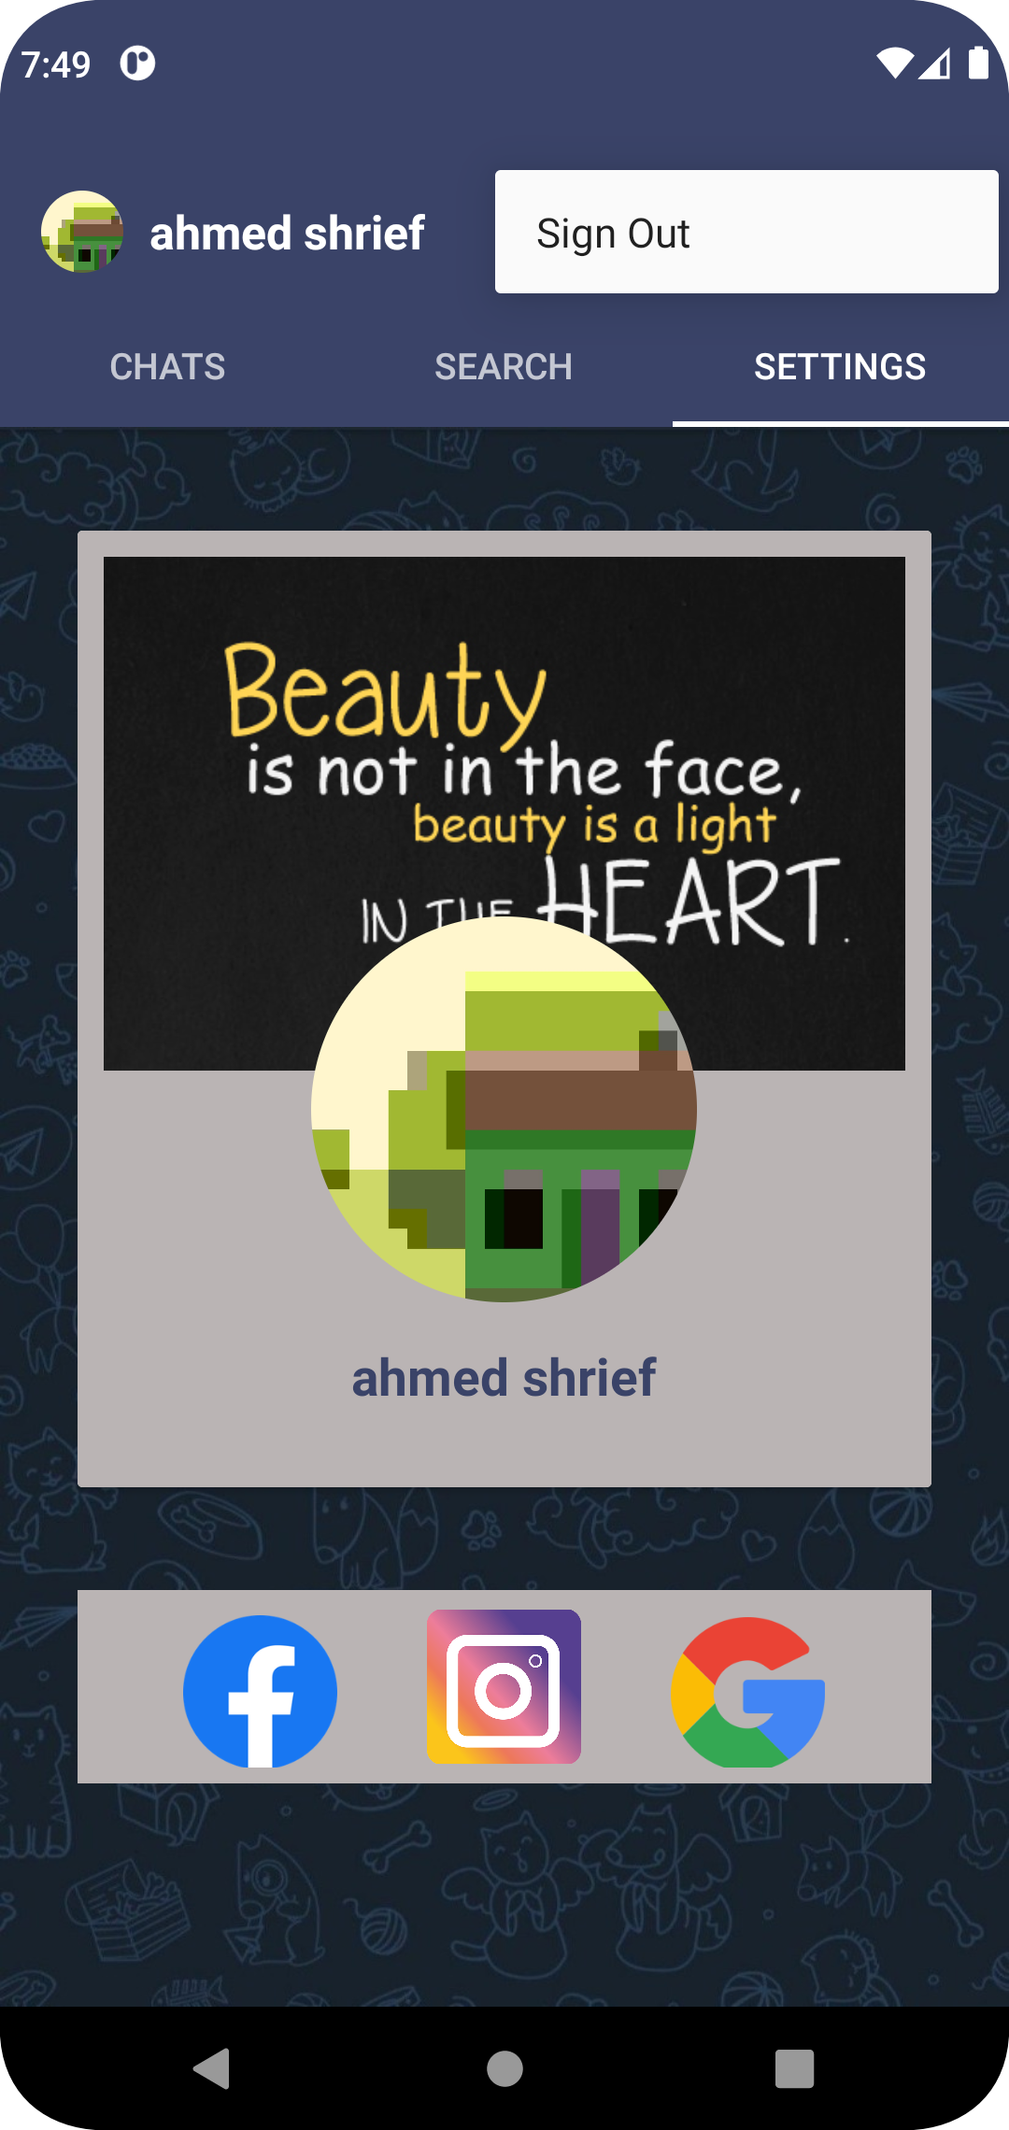
Sign-out…
If you want to sign out from your account, you have the menu tab in the to right of page.
You just press on it and have successful signing out.

